Slide 1

Detecting Network Anomalies
Analyzing raw network logs to identify and predict abnormal behaviors.

Slide 2
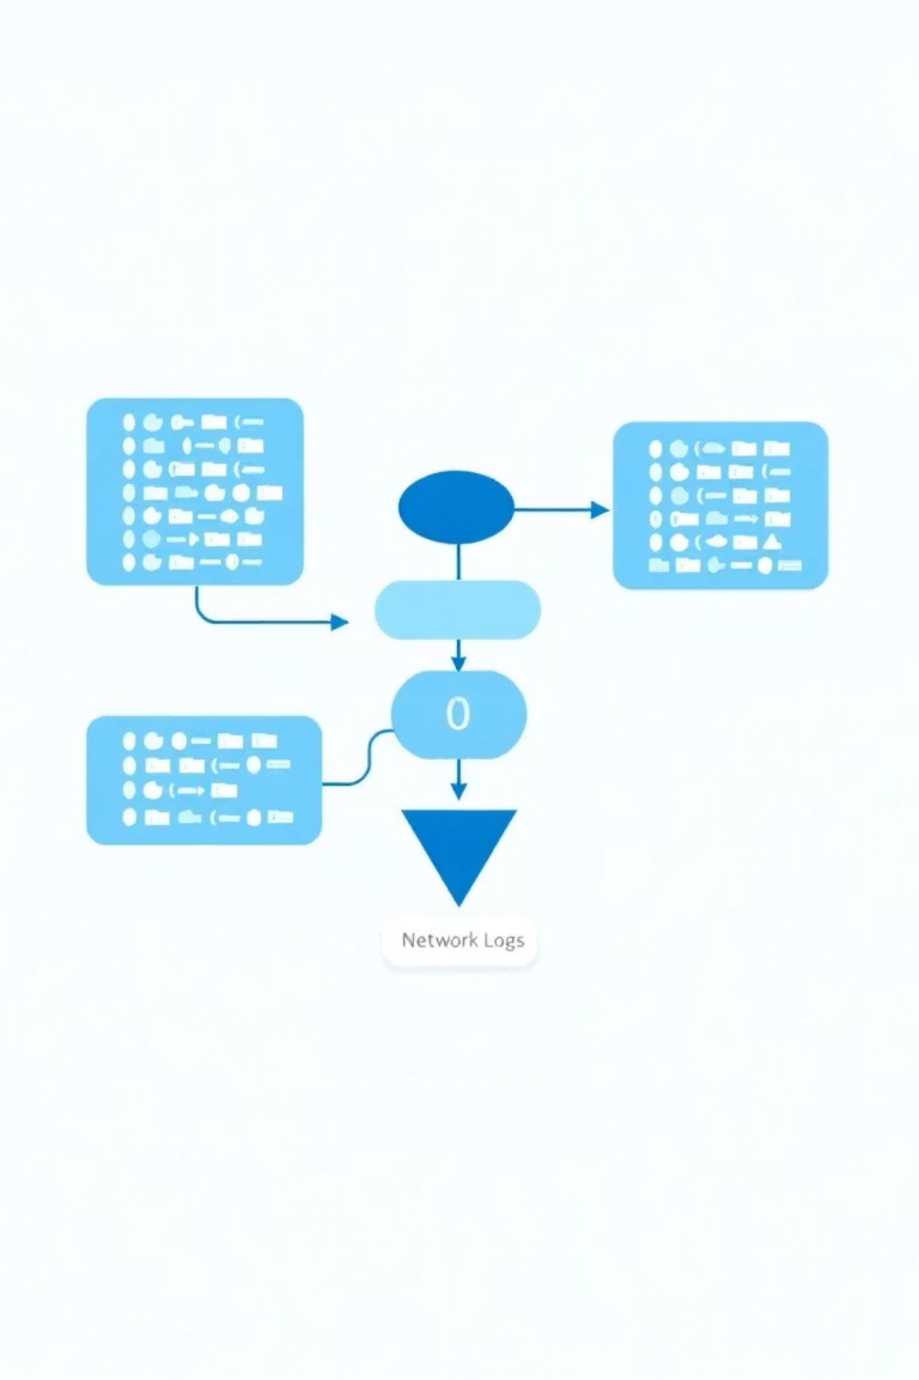
PART 1
The Challenge: From Unstructured Logs to Actionable Insights
Our project tackles the critical task of detecting anomalous activities within raw network logs. This involves transforming vast amounts of unstructured text data into a structured format suitable for machine learning models.
Binary Classification
Normal vs. Suspect
Multiclass Prediction
Identifying Failure Types

Slide 3
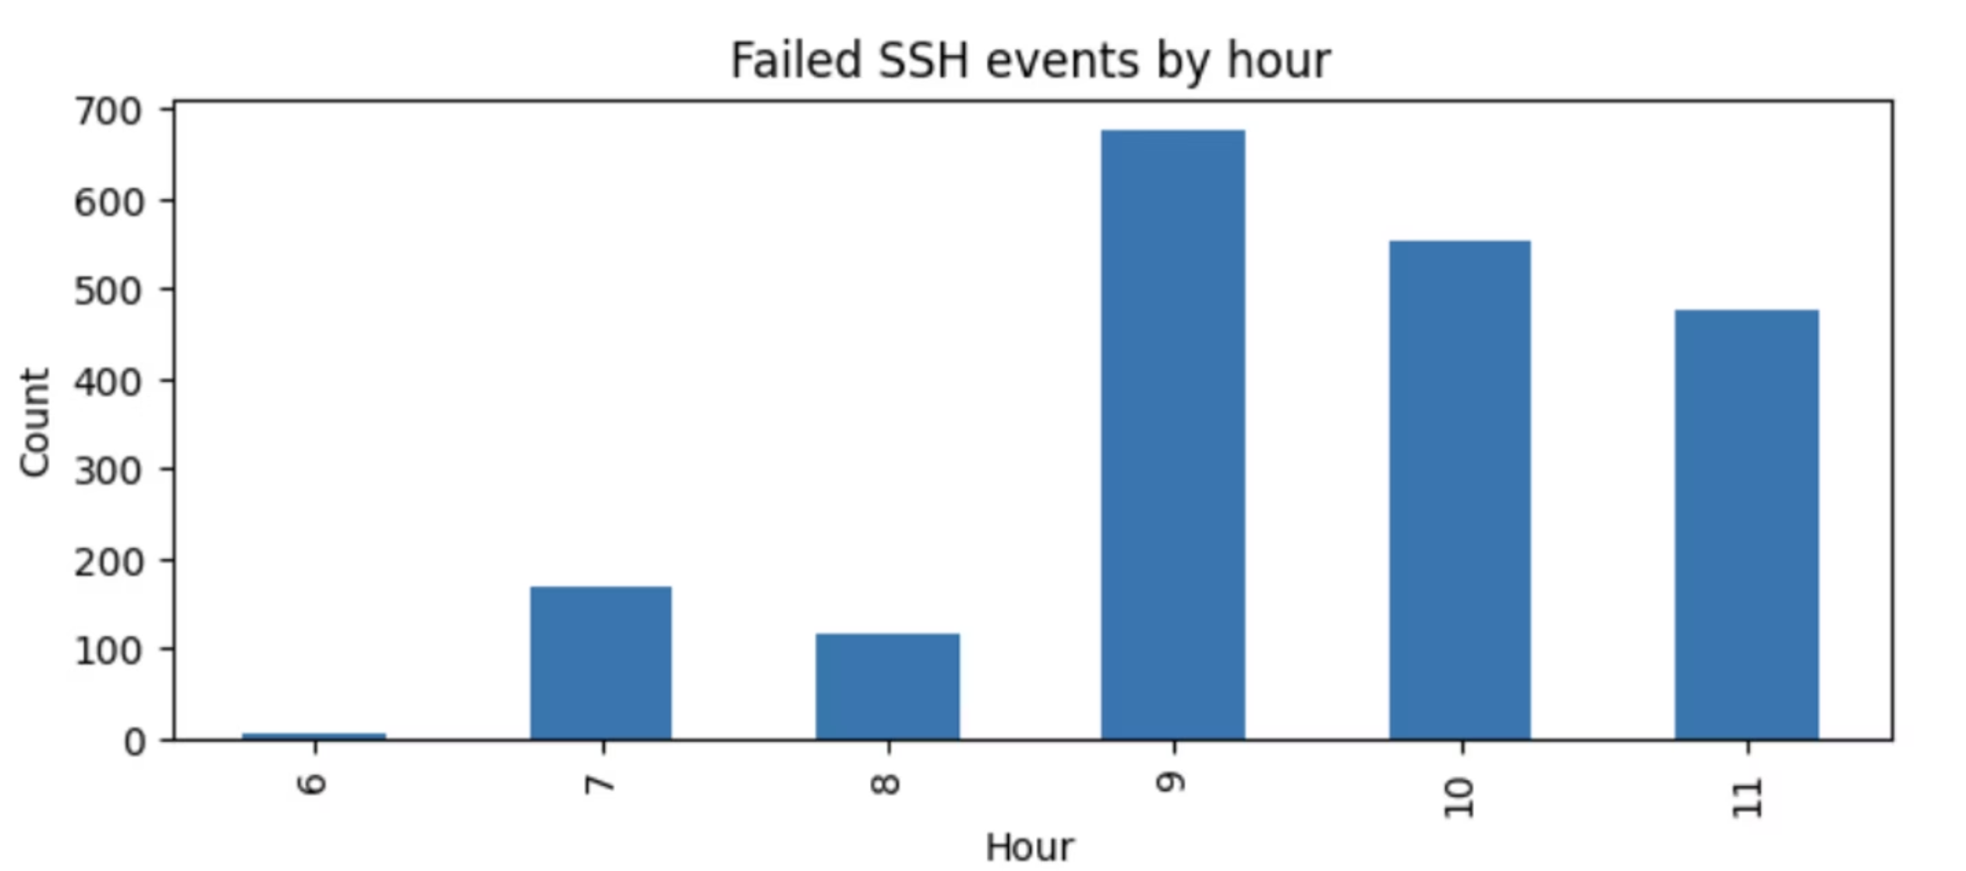
Preprocessing: Structuring the Unstructured
The initial phase focused on meticulously preparing the raw log data for analysis.

Slide 4





This involved a series of crucial steps to extract meaningful features and clean the dataset.
Data Extraction
Extracting critical entities like IP addresses, usernames, ports, and the preauth flag.
Temporal Features
Converting timestamps and deriving the 'Hour' variable for time-based analysis.
Session Aggregation
Creating the 'connections per hour' feature to capture activity density.
Data Cleaning
Systematic handling of missing values to ensure data integrity.
Target Encoding
Reducing 'EventId' to the binary 'Normal/Suspect' for classification.

Slide 5
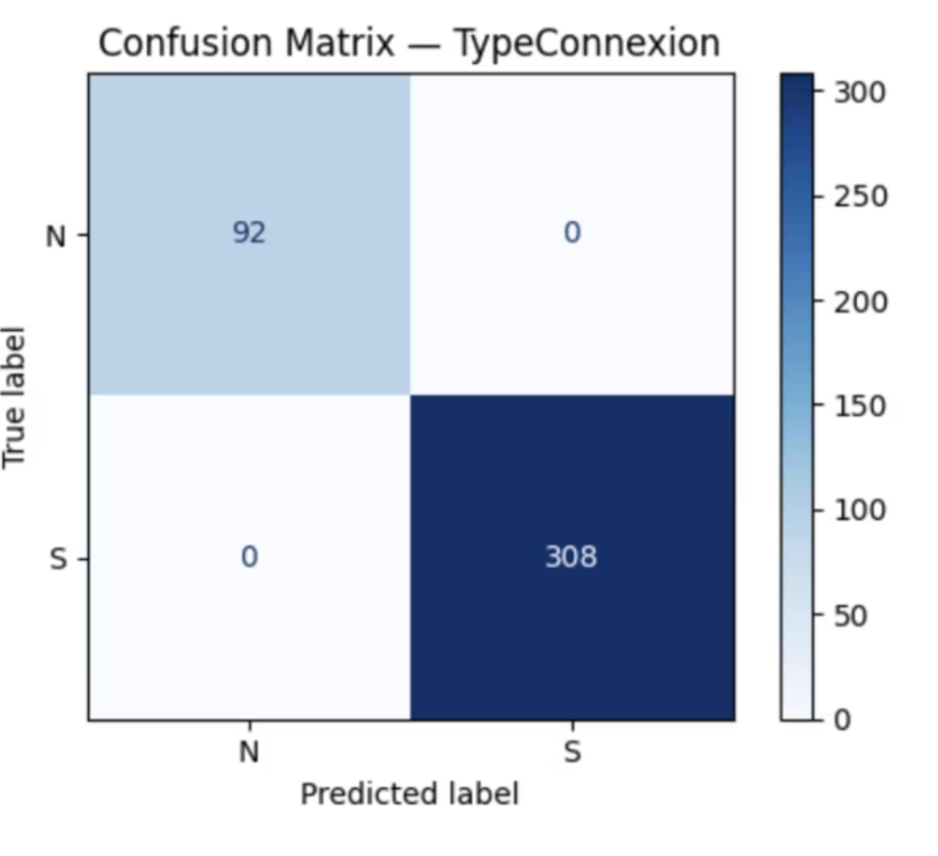
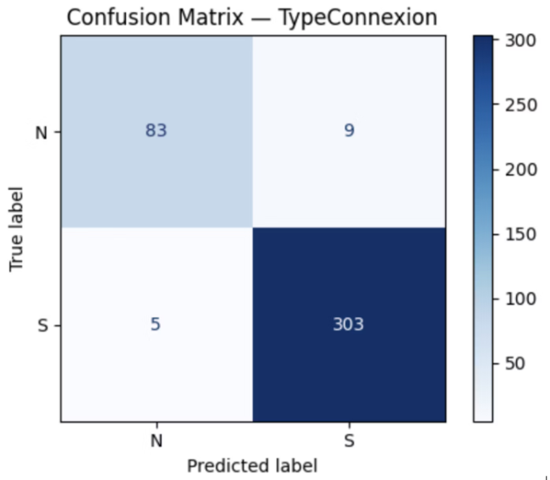
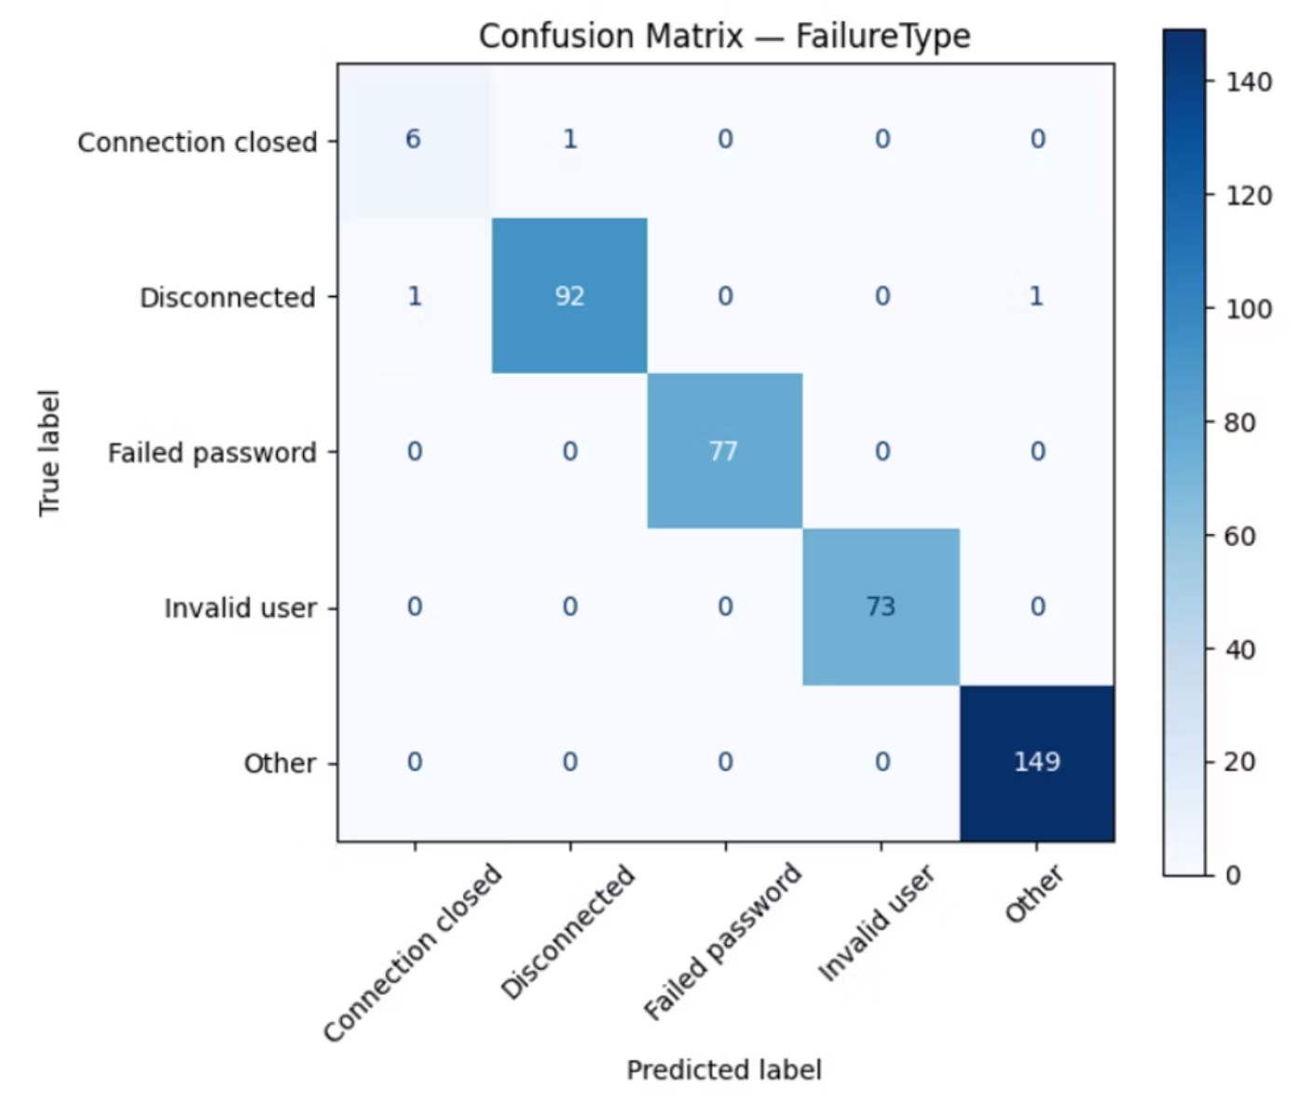
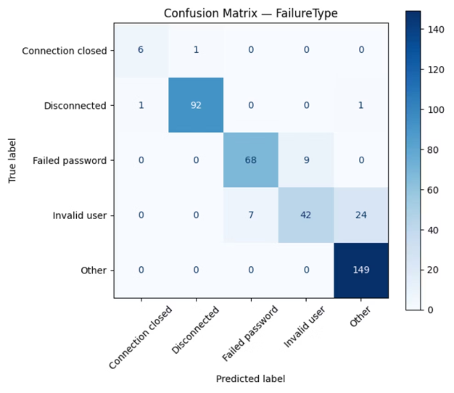
PART 2
Model Selection & Baseline Performance
We initiated our anomaly detection efforts with two foundational machine learning models to establish a performance benchmark.
Logistic Regression
Applied for the binary classification task: distinguishing between Normal and Suspect network activities.
Linear SVM
Utilized for the multiclass prediction of 'FailureType', identifying specific categories of anomalies.

Slide 6



Establishing Realistic Performance
After addressing feature leakage by removing user and IP-specific attributes, our baseline models achieved robust performance, demonstrating the potential for effective anomaly detection.
96.5%
Binary Classifier Accuracy
Achieved for Normal vs. Suspect detection.
89%
FailureType Classifier Accuracy
Effectiveness in identifying various anomaly types.

Slide 7


Understanding Model Decisions: Confusion Matrices
The confusion matrices below provide a detailed breakdown of our models' performance, showing correct and incorrect classifications for both binary and multiclass tasks.
Binary Classifier: Normal vs. Suspect
Multiclass Classifier: FailureType
These visualizations are crucial for identifying specific areas where the models excel and where further improvements might be needed.

Slide 8

PART 3
Optimization Attempts & Identified Limitations
We explored advanced techniques to further enhance model performance, alongside identifying key constraints inherent in our current dataset.
Optimization Strategies
Current Limitations
Small Dataset Size: Restricts the complexity of models and generalizability.
GridSearch
Hyperparameter tuning for both Logistic Regression and Linear SVM, yielding minimal performance gains.
Class Imbalance: Poses challenges for accurately detecting rare anomaly events.
Ensemble Learning
Implementation of Bagging and Voting classifiers, which matched baseline performance without significant improvement.
Limited Text Variability: Reduces the effectiveness of text-based feature engineering.

Slide 9
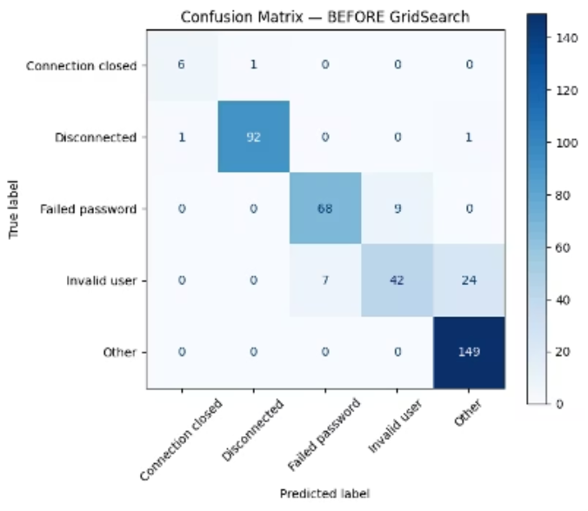
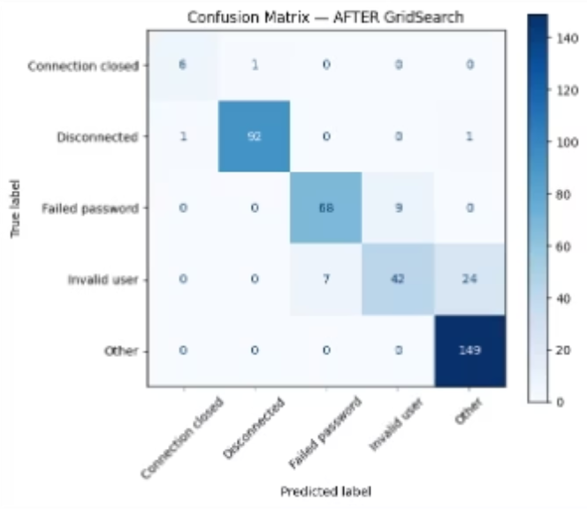
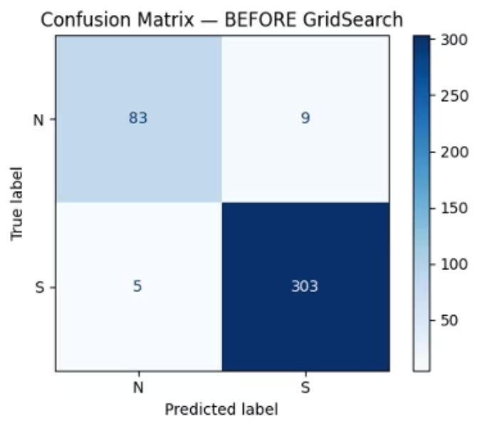
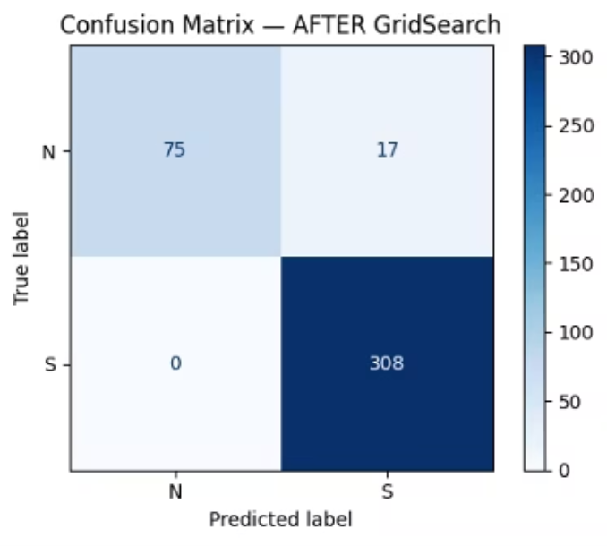
GridSearch
Linear SVM
GridSearchCV did not improve performance: the confusion matrices remain nearly identical due to dataset size and class imbalance.
Logistic Regression
After GridSearch, the model became more sensitive to Suspect events (zero false negatives) but produced more false positives, increasing total errors.

Slide 10
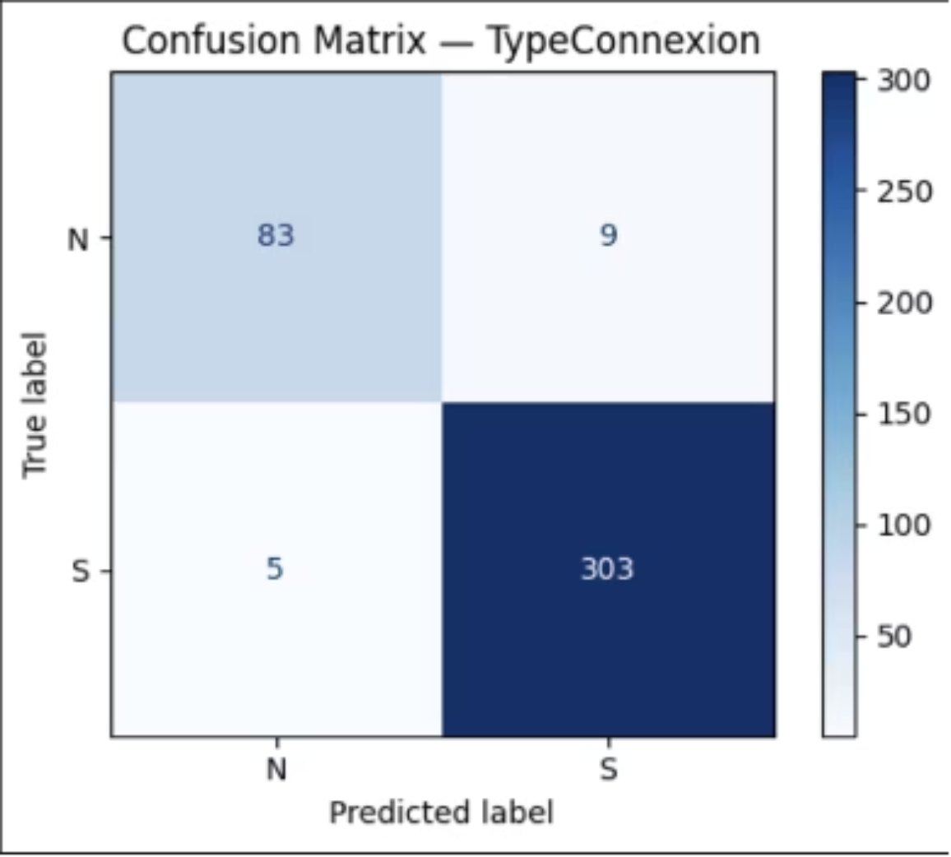
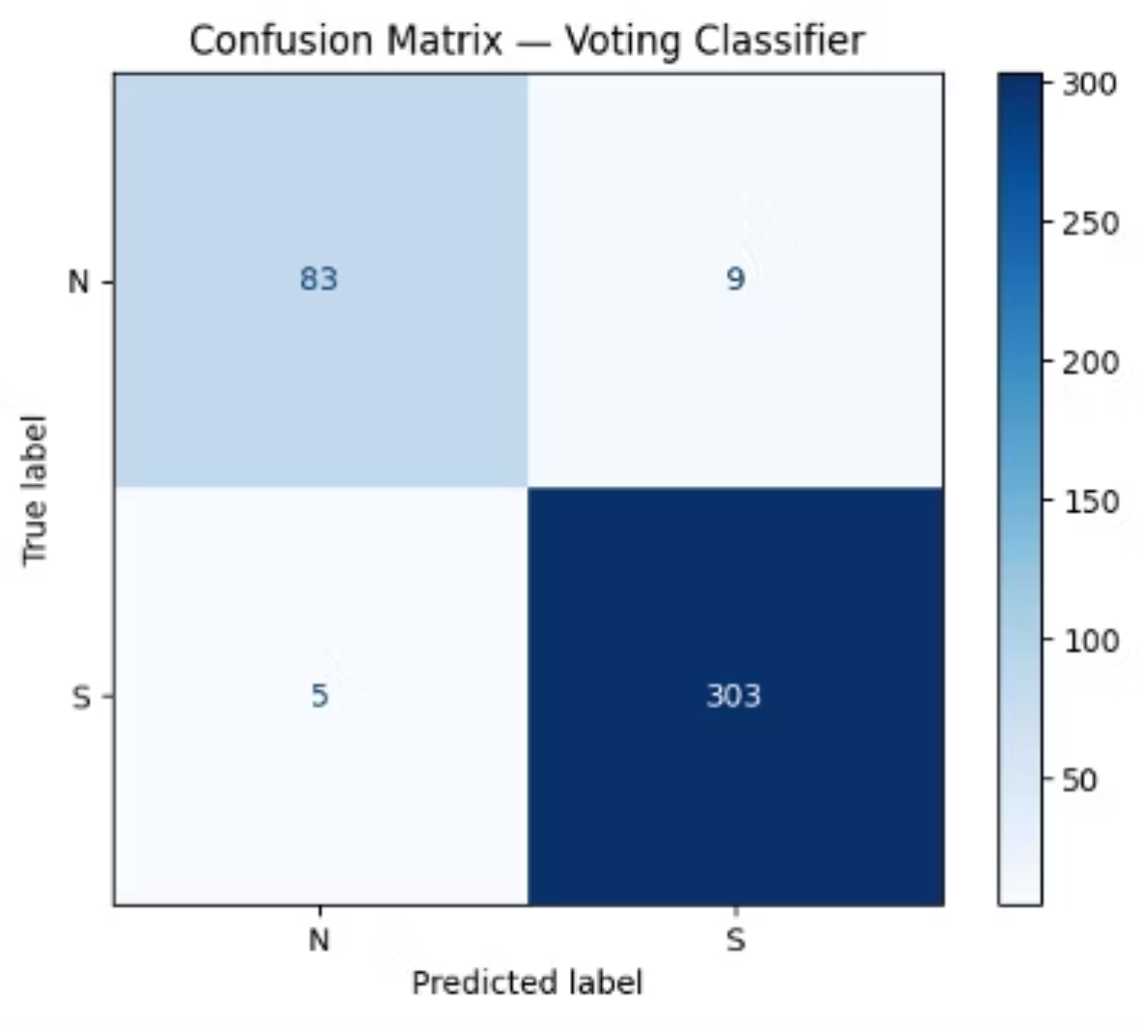
Ensemble Modeling
Logistic Regression
The Voting Classifier replicates the baseline results exactly, confirming that ensemble methods did not improve performance on this dataset.

